Slide 1
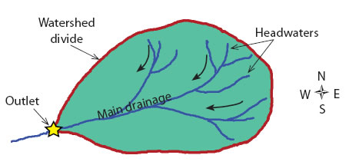
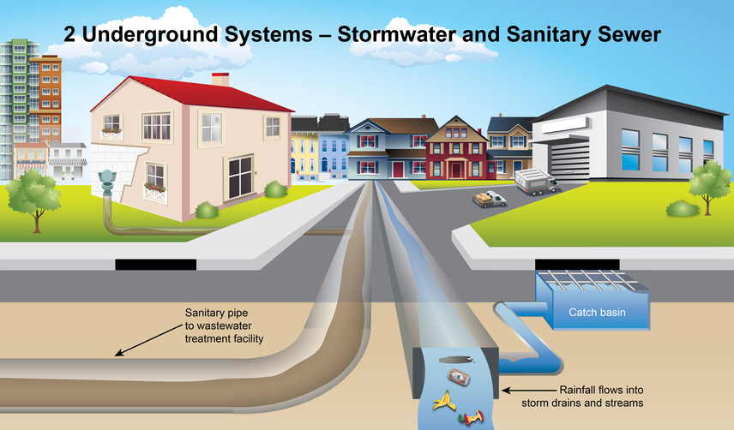
Stormwater Choice Board!
Which way does
the water go?
Journey of a Raindrop
Point Source and
Nonpoint Source Pollution
What Water Goes Where?
What Can YOU Do?
Individually, choose at least FOUR activities on the choice board.
FIRST, click here to watch a video.
Pervious vs. Impervious Surfaces
[Logos for FOR Clean Drains and CIty Utilities]

Slide 3
Which way does the water go?
Example:
Notice the darker black arrows? They are showing which way the water flows to a larger body of water (the outlet).
YOUR JOB:
Drag the arrows onto this watershed map to show which way the water flows. (use more than 3 arrows)

Slide 4
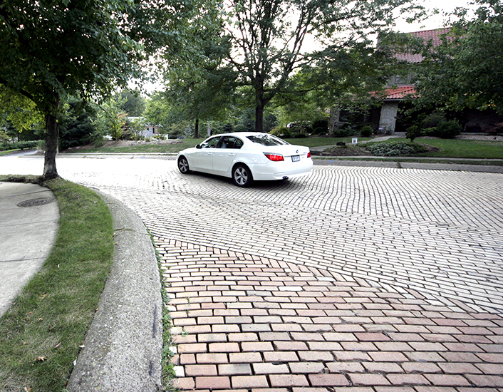
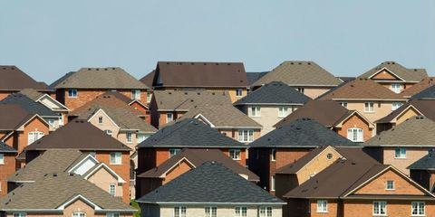
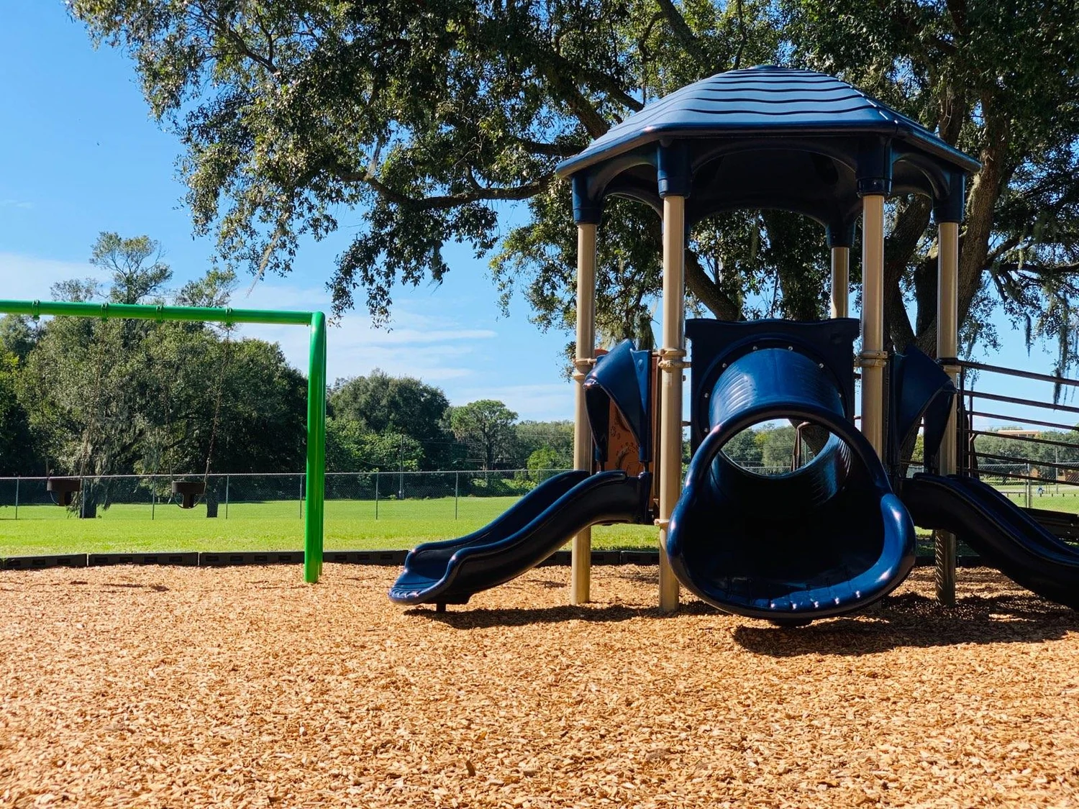
What’s the Difference? Pervious vs. Impervious Surfaces
A pervious surface allows water to seep through to the area underneath rather than becoming runoff water. Impervious surfaces are solid surfaces that prevent water from soaking into the ground. Click here to learn more.
Directions: Look at the pictures below. Decide if that surface is pervious or impervious. Then drag the picture under the correct heading.
PERVIOUS SURFACE
IMPERVIOUS SURFACE

Slide 5
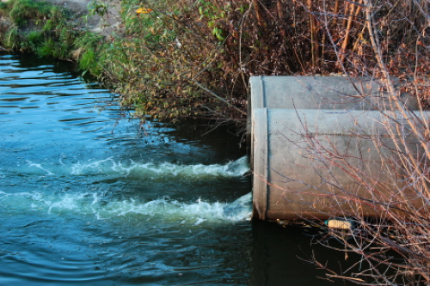
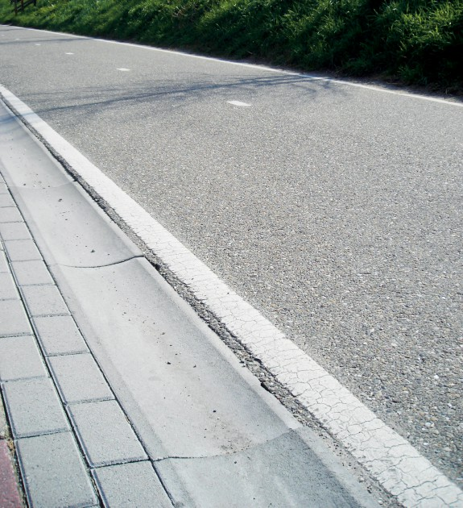
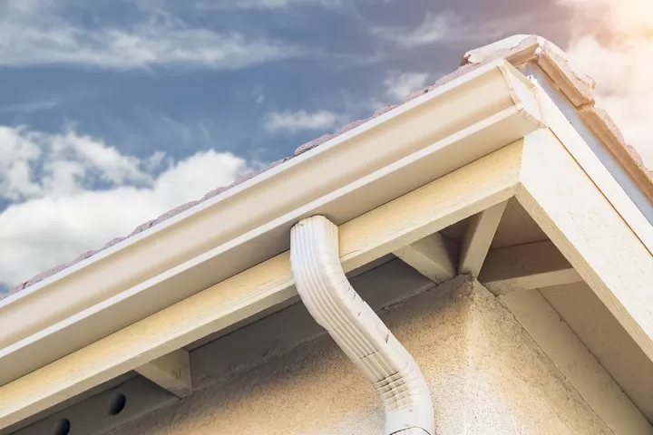
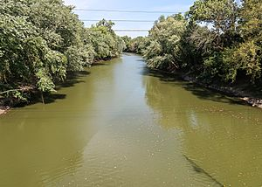
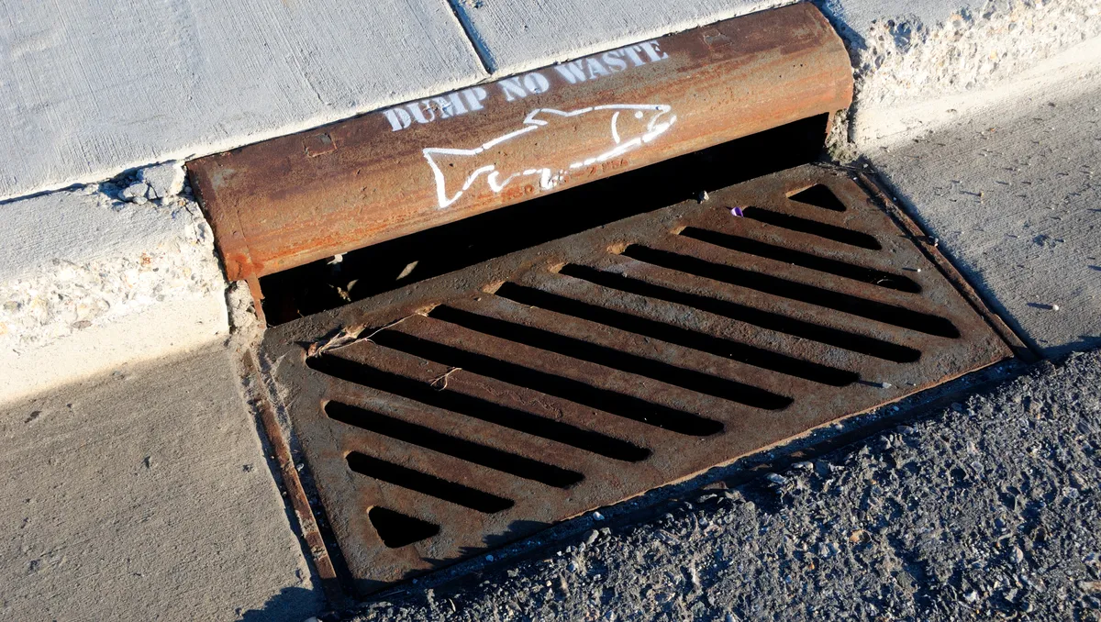
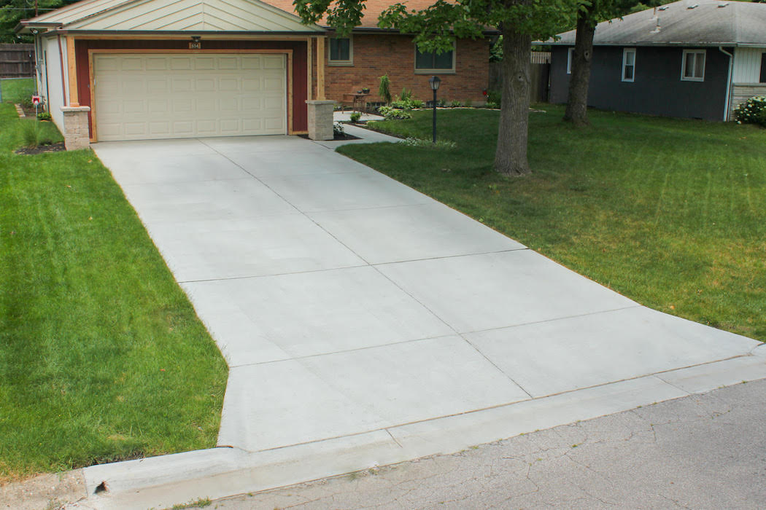
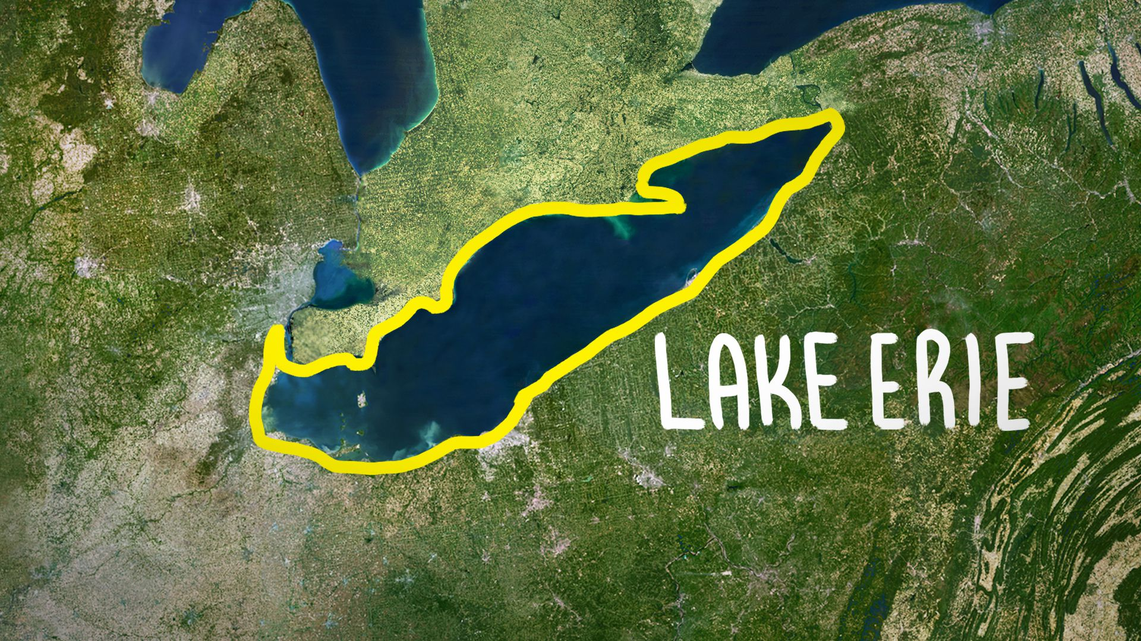
Journey of a Raindrop
1
Watch this video about the journey of a raindrop.
Then drag each image in the correct order to show a raindrop’s journey.
2
3
4
Maumee River
5
6
7
8

Slide 6
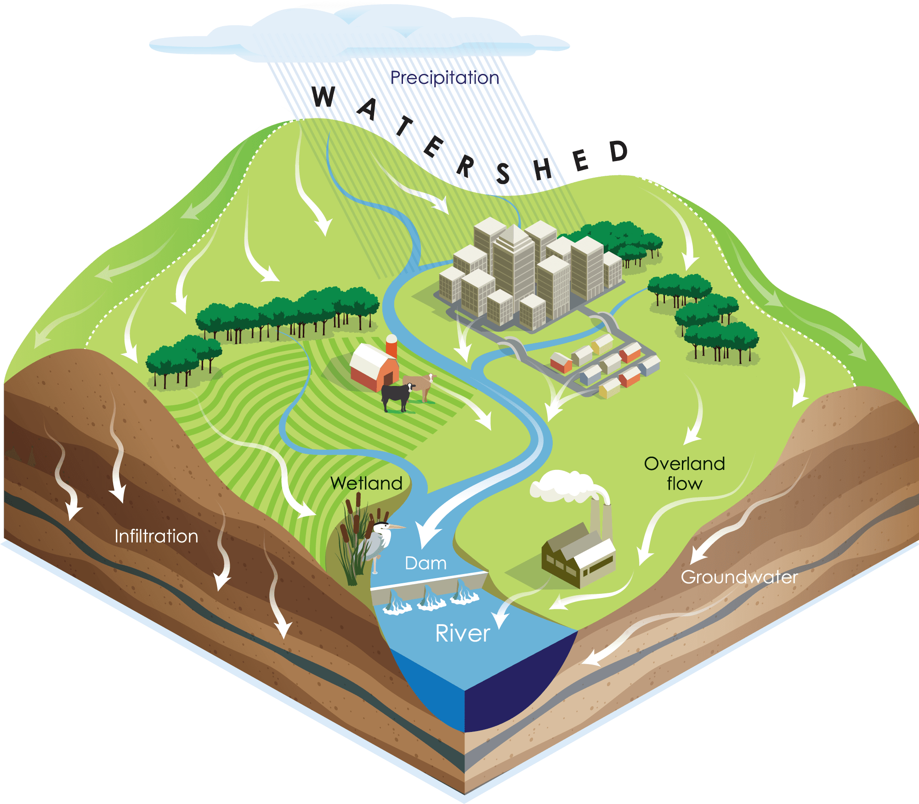
Point Source and
Nonpoint Source Pollution
Watch this video about different types of pollution.
Drag the pollution icon to the area on the watershed that it comes from.
Nonpoint Source Point Source
Loose Soil
Animal Waste
Fertilizer from Fields
Car Oil
Weed Killer
Manufacturing Plant Releasing Chemicals
Overflow from a Sewage Treatment Plant

Slide 7
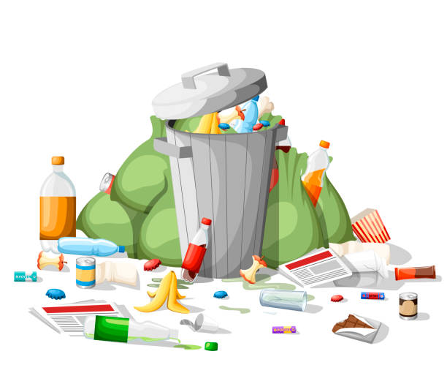
What Water Goes Where?
Water do not all go to the same place. It depends on where it comes from. Water that you use in your house and at school goes into a wastewater treatment plant to speed up the purification process before it is put back into the environment. The Storm Drain System, however, drains DIRECTLY into the environment (rivers and lakes). That means that any pollution that goes into a storm drain ends up in our rivers! Gross!
Your Job: Move the pollution icons to either the Wastewater Treatment Plant side or the Storm Drain Pipe to show where different pollutant end up.
Wastewater Treatment Plant
Storm Drain Pipe
Pollution Icons
Shampoo Human Animal Litter Car Oil Soap Dead Weed
Waste Waste Animals Killer

Slide 8
What Can YOU Do?
Click here to watch this video!
Answer the questions below.
Name three (3) things you can do to help keep your local storm drains clean.
Name three (3) people who can help you keep your local storm drains clean.
If you could create a message for your community about storm drains, what would it be?

